Slide 1
Microbial Community Profiling Matt Settles, PhD University of California, Davis settles@ucdavis.edu
Bioinformatics Core
Genome Center
UC Davis
bioinformatics.ucdavis.edu

Slide 2
Disclaimer
This talk/workshop is full of opinion, there are as many different way to perform analysis as there are Bioinformaticians.
My opinion is based on over a decade of experience and spending a considerable amount of time to understand the data and how it relates to the biological question.
Each experiment is unique, this workshop is a starting place and should be adapted to the specific characteristics of your experiment.

Slide 3
Outline
This workshop is intended for those who are interested in and are in the planning stages of conducting an experiment to study microbial communities using amplicon based methods (16S, ITS, etc.). Topics to be discussed will include:
Bioinformatics IS a Data Science
The difference between Microbial Community Analysis and Metagenomics
Experimental Design
Sample preparation, best practices
High throughput sequencing basics and choices
Cost estimation
Microbial Community Analysis
Data cleanup and quality assurance
Assigning reads to taxa and counting
Analysis of the output
Downstream analysis/visualizations and tables

Slide 4
Bioinformatics IS a Data Science
Section

Slide 5
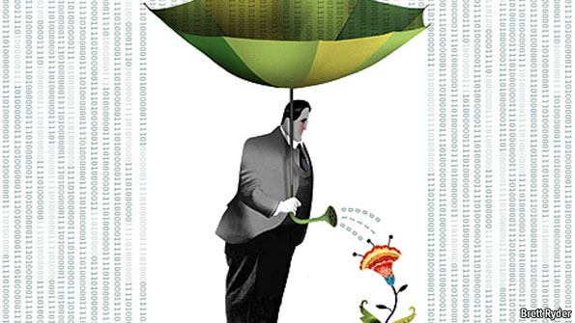
The data deluge
Plucking the biology from the Noise

Slide 6
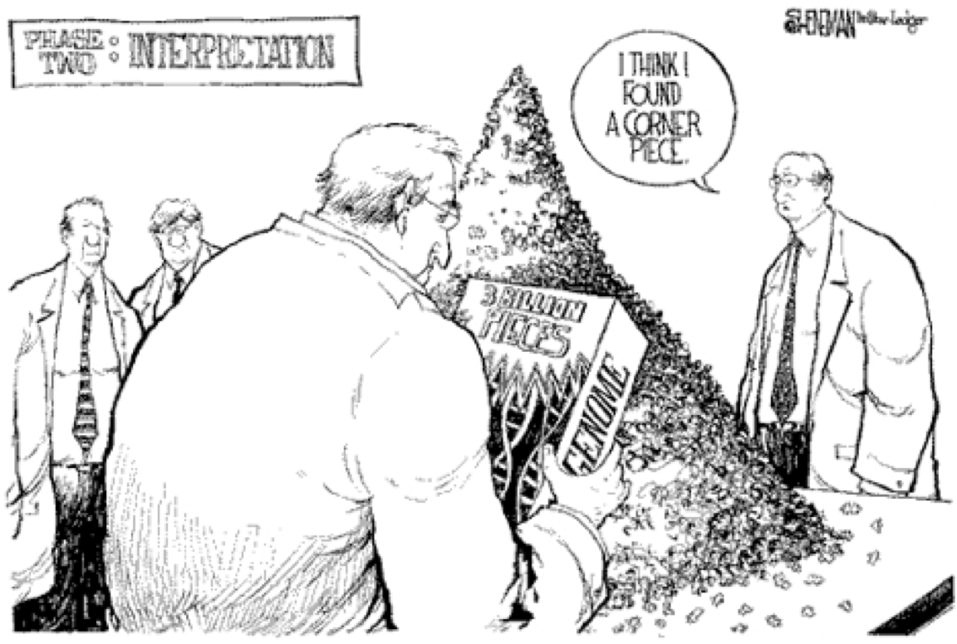
Reality
Its much more difficult than we may first think

Slide 7
Data Science
Data science is the process of formulating a quantitative question that can be answered with data, collecting and cleaning the data, analyzing the data, and communicating the answer to the question to a relevant audience.
Five Fundamental Concepts of Data Science
statisticsviews.com November 11, 2013 by Kirk Borne
Notes:
Kirk Borne – George Mason University

Slide 8
HTS Experiment Philosophy
Design
Experiment
Prepare Libraries
Analyze
Perform Experiment
Sample and Extract RNA/DNA
Sequence
Interpret

Slide 9
7 Stages to Data Science
Define the question of interest
Get the data
Clean the data
Explore the data
Fit statistical models
Communicate the results
Make your analysis reproducible

Slide 10
Bioinformatics done well
Data science done well looks easy – and that’s a big problem for data scientists
simplystatistics.org
March 3, 2015 by Jeff Leek

Slide 11


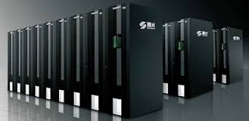
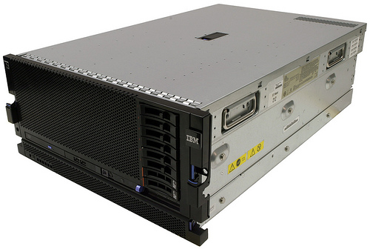

Substrate
Cloud
Computing
Cluster
Computing
BASTM
LINUX
Laptop & Desktop

Slide 12








Environment
“Command Line” and “Programming Languages”
Open
Source
VS
Bioinformatics Software Suite

Slide 13
Prerequisites
Access to a multi-core (24 cpu or greater), ‘high’ memory 64Gb or greater Linux server.
Familiarity with the ’command line’.
Basic knowledge of how to install software
Basic knowledge of R and statistical programming
Basic knowledge of Statistics and model building
At least one programming language (eg python)

Slide 14
Bioinformatics
Know and Understand the experiment
“The Question of Interest”
Develop a deep familiarity and understanding of the techniques/tools/methods
Build a set of assumptions/expectations
Mix of technical and biological
Spend your time testing your assumptions/expectations
Don’t spend your time finding the “best” software
Don’t under-estimate the time Bioinformatics may take
Be prepared to accept ‘failed’ experiments

Slide 15
THE Bottom Line
The Bottom Line:
Spend the time (and money) planning and producing good quality, accurate and sufficient data for your experiment.
Get to know to your data, develop and test expectations
Result, you’ll spend much less time (and less money) extracting biological significance and results during analysis.

Slide 16
Amplicons vs. Metagenomics
Metagenomics
Shotgun libraries intended to sequence random genomic sequences from the entire bacterial community.
Can be costly per sample ($500 to multi thousands per sample)
Better resolution and sensitivity to characterize the sample
Due to cost, can only do relatively few samples
Amplicon community profiling
Sequence only one regions of one gene (e.g. 16s, ITS, LSU)
Cheap per sample (at scale, down to $20/sample)
Due to cost, can do many hundreds of samples make more global inferences

Slide 17
Metagenomic Sequencing Designs
Taxonomic Identification
Amplicon based (e.g. 16s variable regions)
Shotgun Metagenomics
Functional Characterization
Shotgun Metagenomics
Shotgun Metatranscriptomics (active)
Genome Assembly, Function and Variation
Shotgun Metagenomics
Shotgun Metatranscriptomics

Slide 18
Experimental Design: Community profiling
Section

Slide 19
General rules for preparing samples
Prepare more samples then you are going to need, i.e. expect some will be of poor quality, or outright fail
Preparation stages should occur across all samples at the same time (or as close as possible) and by the same person
Spend time practicing a new technique to produce the highest quality product you can, reliably
Quality should be established using Fragment analysis traces (pseudo-gel images, FOR RNA RIN > 7.0)
DNA/RNA should not be degraded
260/280 ratios for RNA should be approximately 2.0 and 260/230 should be between 2.0 and 2.2. Values over 1.8 are acceptable
Quantity should be determined with a Fluorometer, such as a Qubit.
BE CONSISTENT ACROSS ALL SAMPLES!!!

Slide 20
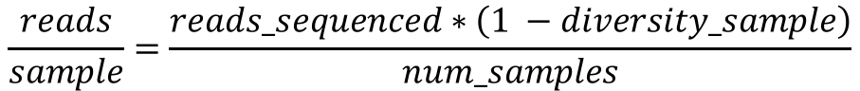
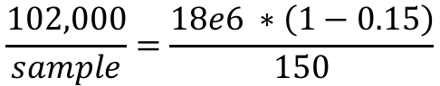
Proposal Stage – Reads per sample
Considerations
Number of reads being sequenced
Proportion that is diversity sample (e.g. PhiX)
Number of samples being pooled in the run
The back of the envelope calculation
$$\frac{reads}{sample}=\frac{reads_sequenced∗\left(1 −diversity_sample\right)}{num_samples}$$
example
$$\frac{102,000}{sample}=\frac{18e6 ∗\left(1−0.15\right)}{150}$$
Recommendations
Illumina ‘recommends’ 100K per sample
I’ve used 30K per sample historically, others are fine with 3K per sample
Really should have as many reads as your experiment needs

Slide 21
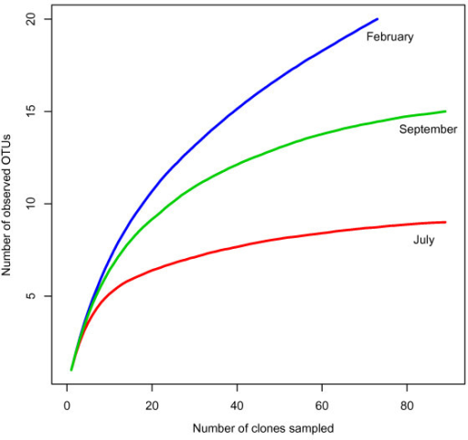
Rarefaction curves
’Deep’ sequence a number of test samples
(~1M+ reads).
Plot rarefactions curves of Amplicons, to determine if saturation is achieved
However:
“Waste Not, Want Not: Why Rarefying Microbiome Data Is Inadmissible”
http://journals.plos.org/ploscompbiol/article?id=10.1371/journal.pcbi.1003531

Slide 22
Take Homes
Experience and/or literature searches (other peoples experiences) will provide the best justification for estimates on needed depth.
‘Longer’ reads are better than short reads.
Libraries can be sequenced again, so do a pilot, estimate ‘contamination’, compute rarefaction/16s coverage then sequence more accordingly.

Slide 23
Cost Estimation
PCR reactions
Library QA/QC (Bioanalyzer and Qubit/microplate reader)
Pooling
Sequencing (Number of Lanes / runs)
Because sequencing is an absolute cost, community profiling gets cheaper per sample the more you pool together. I have pooled as much as 1500 amplicons on one MiSeq V3 sequencing run.
Bioinformatics (General rule is to estimate the same amount as data generation, i.e. double your budget)
http://dnatech.genomecenter.ucdavis.edu/prices/

Slide 24
Sequencing
Illumina

Slide 25
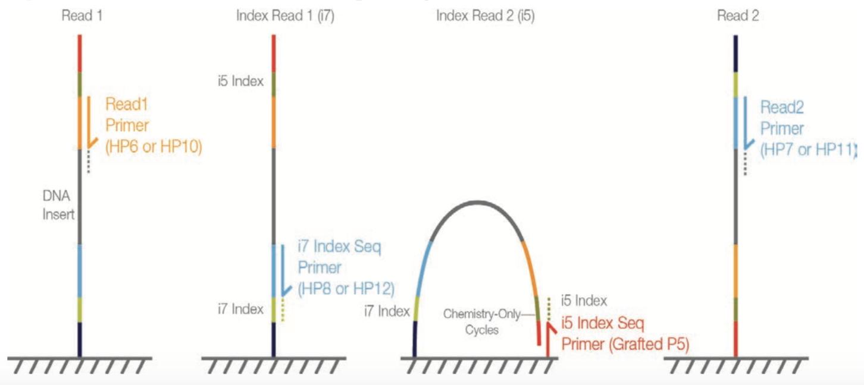
Illumina sequencing
Read 2 (50-300bp)
Illumina SBS
P5 BC2
Target Region
BC1 P7
BC1 (8bp)
Read 1 (50 - 300bp)
BC2 (8bp)
Insert size
Fragment length

Slide 26
Genomic Reduction
3GB
1X
Whole Genome
RADseq
GBSseq
RNAseq
Capture Techniques
Depth of Coverage
Fluidigm Access Array Amplicons
Genomic reduction allows for greater multiplexing of samples.
You can fine tune your depth of coverage needs and sample size
with the reduction technique
1KB
100000X
Few or Single Amplicons

Slide 27
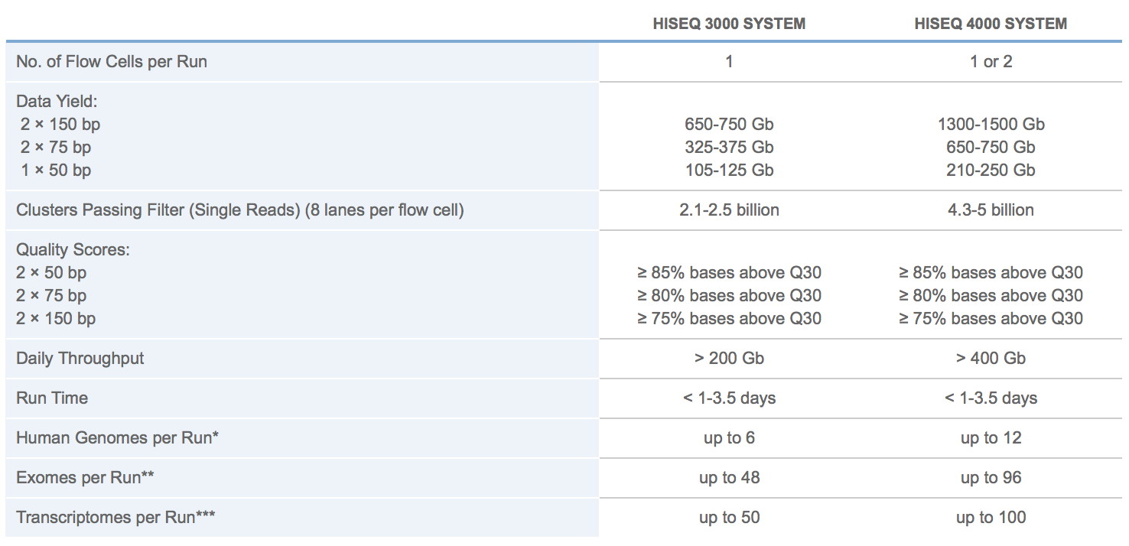
Illumina HISEQ sequencing
http://www.illumina.com/systems/hiseq-3000-4000/specifications.html
2500
MiSeq

Slide 28
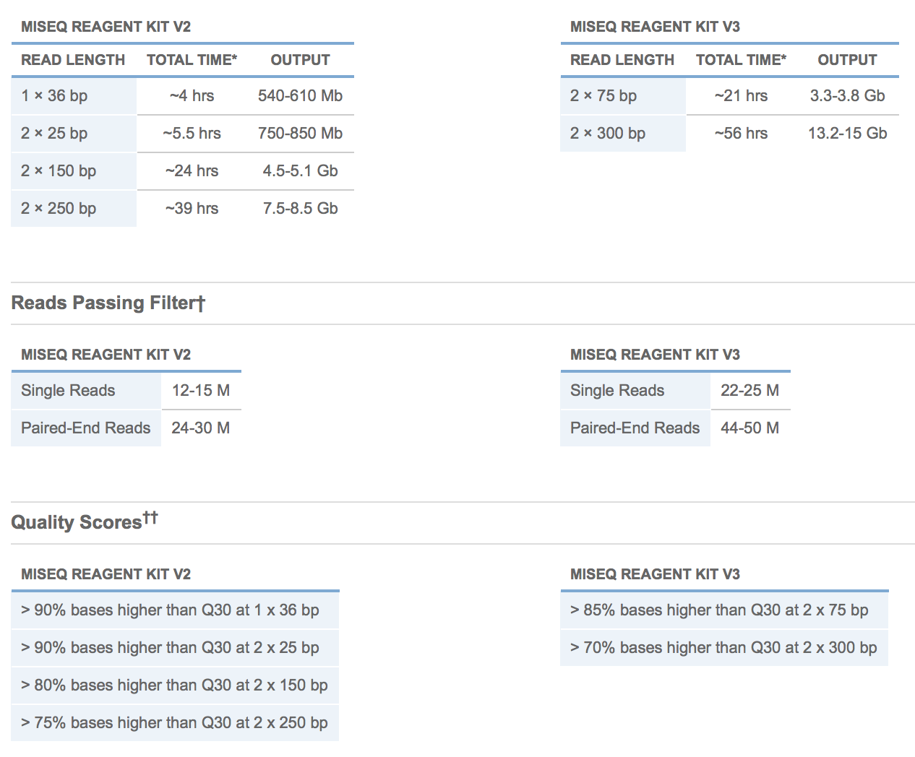
Illumina MISEQ SEQUENCING

Slide 29
Double barcoded primer design
Section

Slide 30
Microbial community analysis
Goal: A culture independent method for profiling the diversity of a community.
High-throughput sequencing technologies (such as Illumina) can generate millions of amplicons, across thousands of samples in a single run, and are today our best approach to deeply assess the environmental or clinical diversity of complex microbial assemblages of archaea, bacteria, and eukaryotes.
Using sequence variation within a common gene (e.g. 16s) to assign and count community members rather than counting individual cells. Assume each sequence variant is one community member.

Slide 31
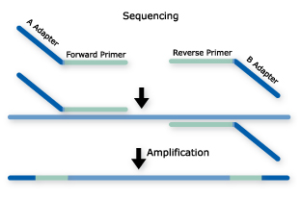
Amplicons: Common Approach
Single PCR
Long primer sequences (up to ~75bp) that contain barcodes and sequencing adapters
Custom sequencing primers amplify from target primer
Single or dual barcodes
(dual barcode are sometimes within read)
Common approach

Slide 32
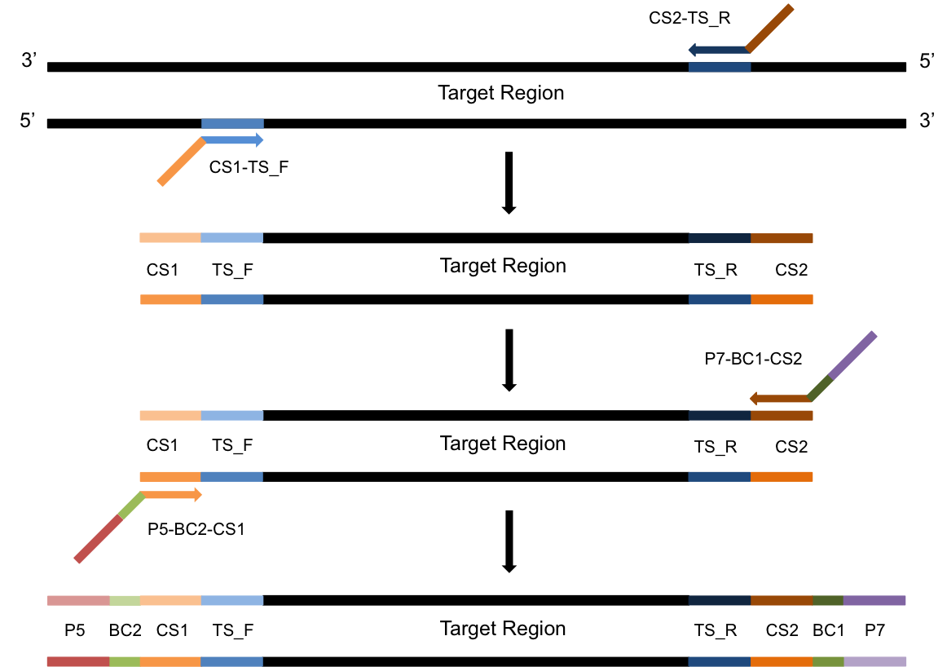
Amplicons: Two Step PCR Approach
PCR-1
Template with overhang
PCR-2
Add barcodes and adapters
Barcodes and adapters are added in the second round of PCR

Slide 33
Multiplex Samples
Dual barcoding allows for massively multiplexing of samples using only a relatively few primers
Pairing of BC1 and BC2 uniquely identifies sample
^{GTATCGTC}
^{TGCTCGTA}
^{GTCGTCGT}
^{GTGCGTGT}
^{GCGTCGTG}
^{GTCGTGTA}
^{GATGTAGC}
^{GAGTGATC}
^{CGCTATCA}
^{CGCTGTAG}
8bp [Error-Correcting]
Barcodes
5 Pairs of Barcodes allows for multiplexing of 25 samples.
32 Pairs can multiplex 1024 samples in the same sequencing reaction

Slide 34
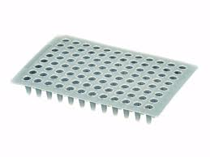
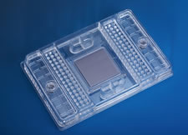
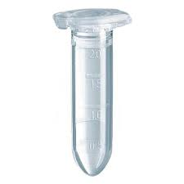
Multiplex Amplicon Targets
Fluidigm Access Array System
PCR-1 product
PCR-2 product
48 samples X 48 amplicons
2304 Two-step PCR reactions
Pool many samples

Slide 35
dbcAmplicons
Originally conceived in late 2012 to lower per sample costs on relatively short targeted (PCR) regions
16S, ITS, LSU, 18S, etc. Community profiling
Extraction of mitochondria, virae, chloroplast regions, plasmids by PCR
Genotyping of samples for phylogenomics, genome to phenotype interactions
Uses the Illumina platform, capably of pooling thousands, or even tens of thousands of barcoded samples/targets per sequencing run.
Core Facility friendly, facilitates interactions between and across individual labs, standardizing workflows.
Consistency across labs leads to predictability in the DNA Technologies Core, which leads to consistency in result.

Slide 36
Primer Design

Slide 37
Template Specific Primer Design
Each primer pair contains the following parts
CS1 or CS2 to attach second adapter/barcode primer
Phase-shifting bases [see below]
Linker sequence
Template specific primer sequence
Phase shifting primer
Phase shifting primers with PCR duplicate detection
CA
CA
TCA
NCA
GTCA
NNCA
AGTCA
NNNCA
CS
TS
CS
TS
Ns, resolve to be PCR duplicate keys
(Unique Molecular Indexes, UMIs)
and should only ever appear once

Slide 38
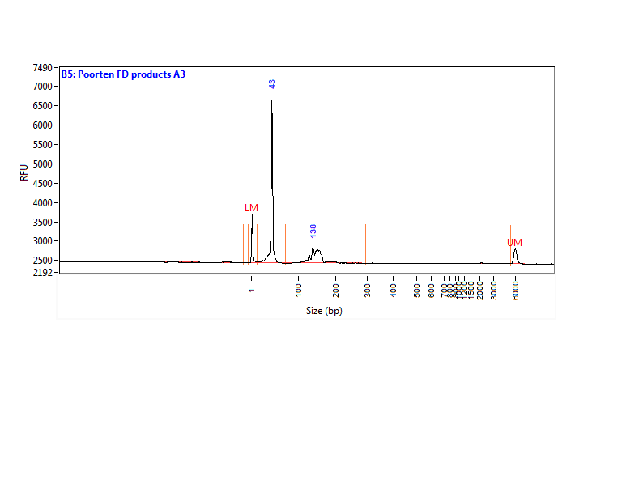
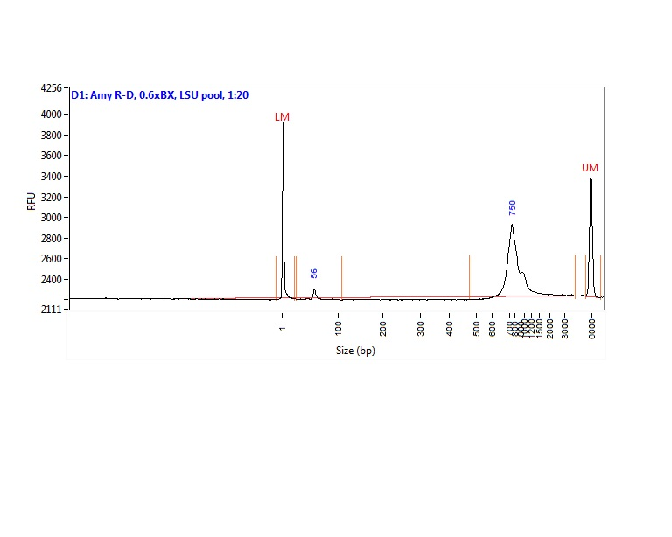
QC: what is a “good” PCR library?
Unused primers and adapters
Unused primer
BAD!
Template of interest
Good!

Slide 39
Pooling Samples/Amplicons
Even amplicon representation is important and difficult to achieve. Amplicon counts can vary from sample to sample by 100x
Each amplicon should be evaluated by quality (ideally by trace) and quantity (fluourometery). Both qualities will effect final counts.
Best practices
First group amplicons by quality/quantity profiles
Pool each group separately
If a small number of groups consider qPCR on each group for final pooling concentrations
If a large number re-quantify and pool to final pool.

Slide 40
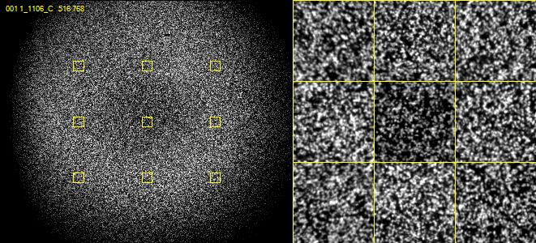
Nucleotide diversity
Critically important for imaging clusters

Slide 41
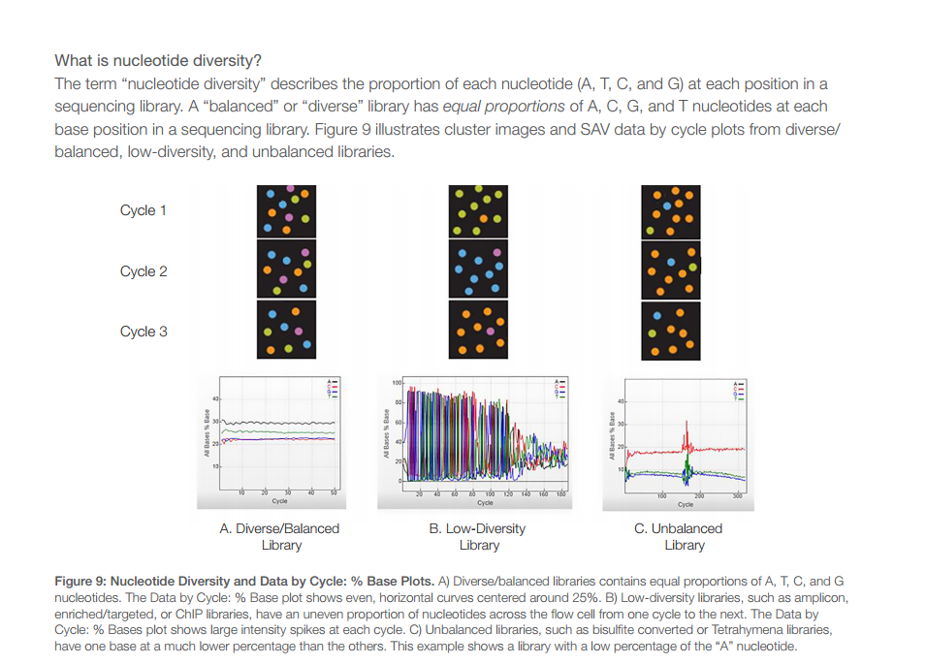
Amplicon runs are Low Complexity
Sequencing with lower cluster density
Adding in highly diverse libraries (shotgun libraries ~15%)
Phase-shifting template specific primers:

Slide 42
Benefits/Drawbacks
Benefits
Maximum Flexibility, fewer target specific primers needed.
Dual barcoding, allowing for massively multiplexing of samples to occur.
Pool multiple targets per run
Software for demultiplexing
Drawbacks
Two – step PCR reaction
Sequence the target specific primer
In my opinion NOT a feature not a drawback

Slide 43
Common Analysis Workflow
Identify barcodes
Identify primer sequence (if present) and trim
Overlap paired end reads to produce single read, full amplified target sequence
Generate operational taxonomic unites (“OTUs”), via clustering or classification
Assign ”OTUs” to an organism
Generate abundance tables
Statistical testing

Slide 44
Common workflows
Qiime
Worst piece of software to install ever
Mothur
dbcAmplicons (my software)

Slide 45
dbcAmplicons
Two-step PCR
highly multiplexed and modular amplicon design
DNA
Performed in Researcher’s Lab
Target Specific
Primer Design
Primer Validation
Dual-barcoded
Two-step
PCR
Pooling
And
Quantification
Python dbcAmplicons application
Performed in Core Facility
Downstream
Analysis
Preprocess:
Demuliplex by barcodes and primer sequences
Illumina Sequencing
Four Read Setup

Slide 46
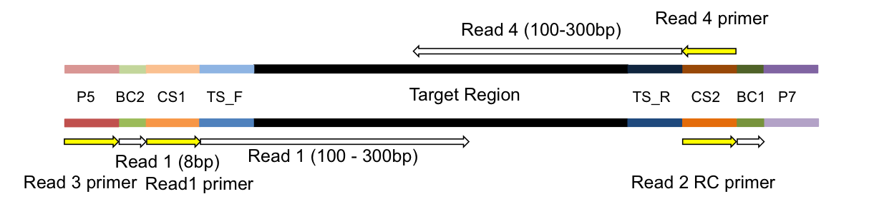
Sequencing
Illumina four read sequencing run
Read | Sequencing Primer
Read1 primer | CS1 - 5’ ACACTGACGACATGGTTCTACA
Read2 primer | CS2 - 5’ TACGGTAGCAGAGACTTGGTCT
BC1 primer | CS2rc - 5’ AGACCAAGTCTCTGCTACCGTA
BC2 primer | Uses the P5 amplification primer

Slide 47
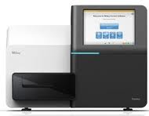
Bioinformatics
Illumina bcl2fastq 1.8.4
Four
Fastq files
Barcode Table
“Preprocess”
Demultiplex barcode and
primer sequences
dbcAmplicons
Python Application
Primer Table
Sample Sheet
Barcode | Match determined by edit-distance, allowing for 1 mismatch per barcode (by default)
Primers | Match determined by Levenshtein Distance allowing for 4 mismatches (by default) with the final 4 (by default) bases required to be perfect matches
Overlap paired reads
(wrapper around custom Flash2)
Downstream Analysis
https://github.com/msettles/dbcAmplicons

Slide 48
Downstream Analysis
Population Community Profiling ( i.e. microbial, bacterial, fungal, etc. )
dbcAmplicons Python Application
Screen | Using Bowtie2, screen targets against a reference fasta file, separating reads by those that produce matches and those that do not match sequences in the reference database.
Classify | Wrapper around the MSU Ribosomal Database Project (RDP) Classifier for Bacterial and Archaeal 16S rRNA sequences, Fungal 28S rRNA, fungal ITS regions
Abundance | Reduce RDP classifier results to abundance tables (or biom file format), rows are taxa and columns are samples ready for additional community analysis.
Targeted Re-sequencing
 | Consensus - Reduce reads to consensus sequence for each sample and amplicon
R-functions to be added into dbcAmplicons | Most Common – Reduce reads to the most commonly occurring read in the sample and amplicon ( that is present in at least 5% and 5 reads, by default )
 | Haplotypes – Impute the different haplotypes in the sample and amplicon

Slide 49
Supplemental Scripts
convert2Readto4Read.py
For when samples are processed by someone else
splitReadsBySample.py
To facilitate upload to the SRA
preprocPair_with_inlineBC.py
Cut our inline BC and create 4 reads for standard input processing
Will work with ”Mills lab” protocol
dbcVersionReport.sh
Print out version numbers of all tools

Slide 50
dbcAmplicons: dependent software
dbcAmplicons
https://github.com/msettles/dbcAmplicons
Flash2, for overlapping reads
https://github.com/dstreett/FLASH2
RDP for classification
https://github.com/rdpstaff/RDPTools
Bowtie2 for screening (if relevant)
https://github.com/BenLangmead/bowtie2

Slide 51
Flash2 – overlapping of reads
Insert size
Insert size > length of the number of cycles
Read 2
Target Region
Read 1
Product: Read Pair
Insert size < length of the number of cycles (10bp min)
Insert size
Read 2
Target Region
Read 1
Product: Extended Single
Insert size < length of the read length
Insert size
Read 2
Target Region
Read 1
Product: Adapter Trimmed Single

Slide 52
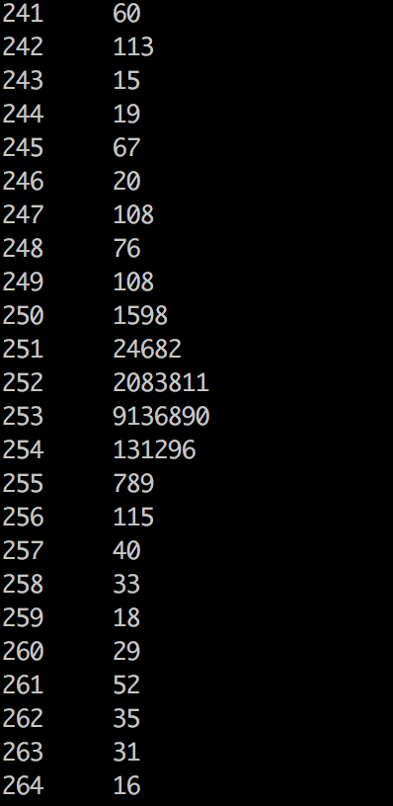
Flash2 typically produces tight sizes

Slide 53
dbcAmplicons: classify
Uses the RDP (Ribosomal Database Project) classifier for bacterial and archaeal 16S, fungal LSU, ITS warcup/unite databases.
Classifies sequences to the closest taxonomic reference provides a bootstrap score for reliability
Concatenates Paired-end reads
Can trim off low quality ends, to some value Q

Slide 54
Direct Classification - RDP
Ribosomal Database Project (RDP) - naïve Bayesian Classifier
Compares each read to a database
Database is updates periodically
Compares by k-mers (15 mers)
100 bootstraps to establish confidence in result
Order does not matter, no 3% !
Drawbacks
Accepts only fasta (though website implies fastq) files
Can be slow
Down to genus only (for 16s, species for ITS)
Kmer database are based on whole 16s
Cannot group together unknown OTUs that represent unique taxa

Slide 55
Direct classification vs clustering
Clustering – “Because of the increasing sizes of today’s amplicon datasets, fast and greedy de novo clustering heuristics are the preferred and only practical approach to produce OTUs”. I DISAGREE
Shared steps in these current algorithms are:
An amplicon is drawn out of the amplicon pool and becomes the center of a new OTU (centroid selection)
This centroid is then compared to all other amplicons remaining in the pool.
Amplicons for which the distance is within a global clustering threshold, t (e.g. 3%), to the centroid are moved from the pool to the OUT
The OTU is then closed. These steps are repeated as long as amplicons remain in the pool.

Slide 56
Reasons why I’m not a fan
Little to no biological rational to any of the clustering parameters, modify the parameters to get a result you like.
Dependent on ordering, reorder our reads you can get different set of OTUs. Often not repeatable from run to run.
3% (or any other cutoff) is BS.
Most clustering algorithms do not consider sequencing errors.
If you generate more data you have to start the clustering process all over again as population of sequences matters.
I’m sure there is more

Slide 57
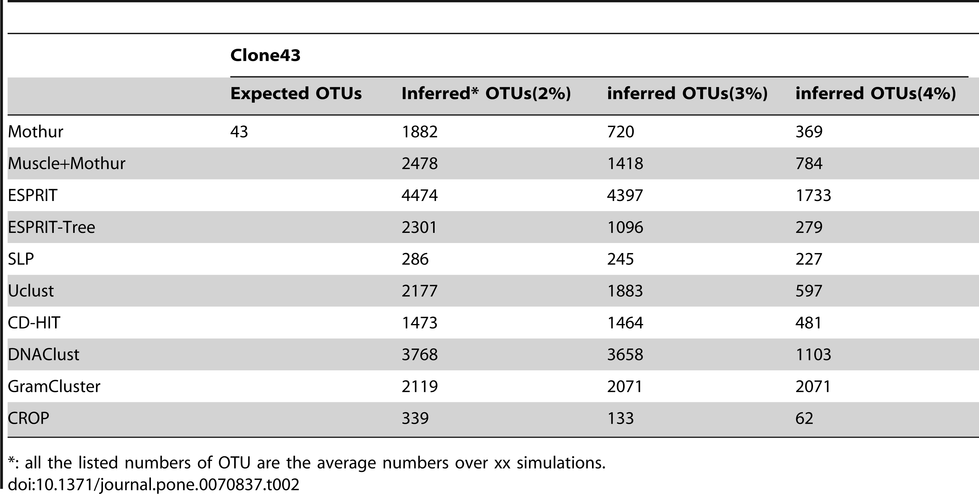

OTU clustering Comparison
Chen W, Zhang CK, Cheng Y, Zhang S, Zhao H (2013) A Comparison of Methods for Clustering 16S rRNA Sequences into OTUs. PLoS ONE 8(8): e70837. doi:10.1371/journal.pone.0070837
http://journals.plos.org/plosone/article?id=info:doi/10.1371/journal.pone.0070837

Slide 58
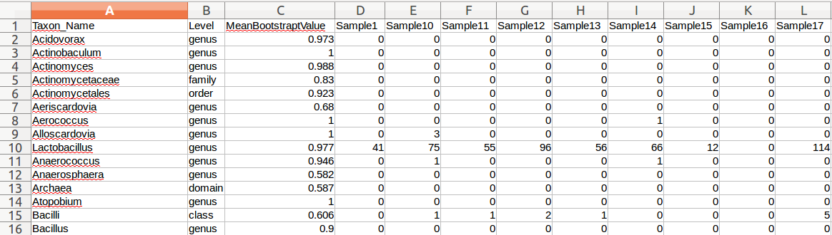
Abundance tables and Biom files
Can open file in spreadsheet; lists lowest taxonomically classified level for each sample by read count
Biom file
The BIOM file format (canonically pronounced biome) is designed to be a general-use format for representing biological sample by observation contingency tables. BIOM is a recognized standard for the Earth Microbiome Project and is a Genomics Standards Consortium supported project.

Slide 59
Future Directions
dbcAmplicons is a data reduction pipeline, produces abundance/biome files, post processing most typically done in R.
Include “error-correcting barcodes” in demultiplexing
Identification of PCR duplicates (using UMI)
Replace RDP classification with another scheme
Have ideas (for years) but no time
Use amplicon length in classification
Include screening of diversity sample in preprocessing to get an idea of actual proportion in the pool
Incorporate the R genotyping pipeline into dbcAmplicons
Extend to inferring copy number (or ploidy levels)
Correct for copy number (16s)

Slide 60
Post Processing
I pretty much do all of my post analysis (abundance table, Biome) in R
Common Packages
Vegan
https://github.com/vegandevs/vegan
Vegetarian
https://github.com/cran/vegetarian
Phyloseq (uses vegan, ade4, ape, picante)
https://joey711.github.io/phyloseq/
Ecological Diversity Analysis
how does the structure of OTU across samples/groups compare
Ordination Analysis (multivariate analysis)
Visualize the relative similarity/dissimilarity across samples, test for taxa/environment relationships
Differential Abundance Analysis (univariate analysis)
Uses tools from RNAseq (limma, edgeR)
Visualization (temporal, heatmaps, ’trees’, more)

Slide 61
Standardization/Normalization
Relative (proportional) abundances
Divide by sum of sample, values 0-100%
LogCPM from RNAseq
Hellinger standardization
http://biol09.biol.umontreal.ca/PLcourses/Section_7.7_Transformations.pdf
Others
Wisconsin

Slide 62
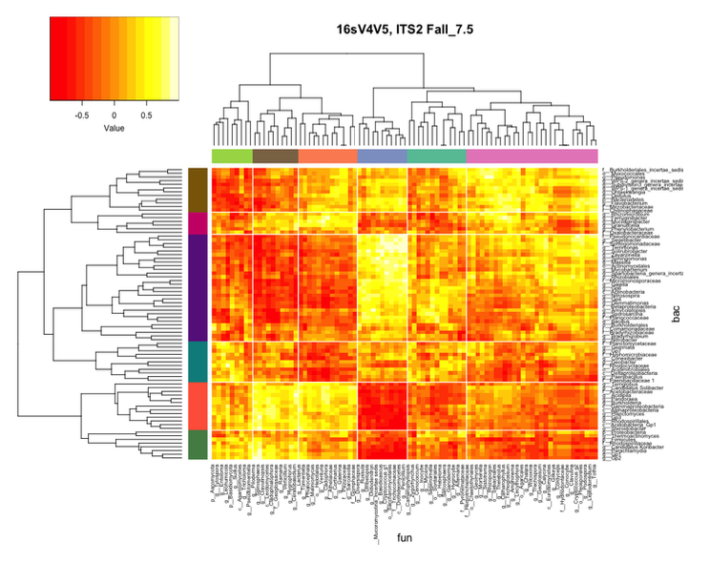
Multi community analysis

Slide 63
Getting Help
Host Microbe Systems Biology Core (HMSB)
http://www.ucdmc.ucdavis.edu/medmicro/hmsbcore/index.html
DNA Extractions
Library Construction
Data Analysis
DNA Technologies Core
http://dnatech.genomecenter.ucdavis.edu/
Illumina Sequencing of Libraries
Bioinformatics Core
http://bioinformatics.ucdavis.edu/
Experimental design
Data analysis
Custom analysis

